Slide 1
EMN Administration New Hire Presentation
March 2023

Slide 2
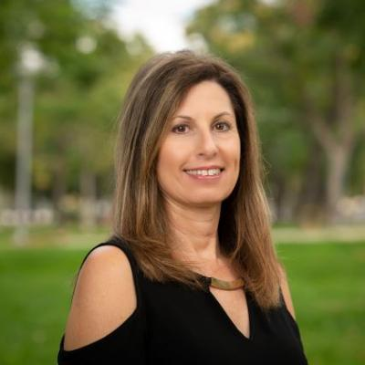
Welcome New Hire
I am very pleased to welcome you as a new employee in the EMN Administration, a unit within the College of Natural & Agricultural Sciences (CNAS). It is my pleasure to welcome you and my personal goal to make EMN Administration a great place to work.
As a member of the EMN Administration, you are also a part of the University of California, Riverside family, go Highlanders!
You’ve made a great decision to join our team.
Sincerely,
Sherice Underwood, Financial and Administrative Officer
EMN Administration

Slide 3
Our Mission
The mission of the EMN Administration is to provide excellent financial and administrative support to the Departments of Evolution, Ecology & Organismal Biology (EEOB); Molecular, Cell & Systems Biology (MCSB); the UCR Natural Reserves (NRS); the Stem Cell Center and Microscopy Core, which all perform research, teaching and community outreach.

Slide 4
College of Natural and Agricultural Sciences (CNAS)
About CNAS
The College of Natural and Agricultural Sciences (CNAS) is home to world-renowned scholars pursuing research that deepens our knowledge of the universe we live in and improves the quality of life for inhabitants of the state, the nation, and the world. Central to this research is educating the students who come to CNAS to learn science, and who leave with an integrated grasp of how they can change the world. These students, and the faculty who teach them, benefit from a structure that is unique among land-grant colleges: CNAS’s 13 departments encompass the life, physical, mathematical, and agricultural sciences. This structure encourages an extraordinary degree of collaboration, reflected in the interdisciplinary research centers and the many cooperatively taught degree programs. Modern science is team based, and CNAS embodies that principle in everything it teaches and practices.
CNAS Mission
To transform lives through discovery, communication, translation, application, and preservation of knowledge.
CNAS Vision
To enhance our position as a preeminent research college that epitomizes excellence in all that we do:
Advancing and communicating knowledge
Developing and inspiring future leaders
Transforming communities
Demonstrating that diversity is both a measure of excellence and a means of achieving it

Slide 5
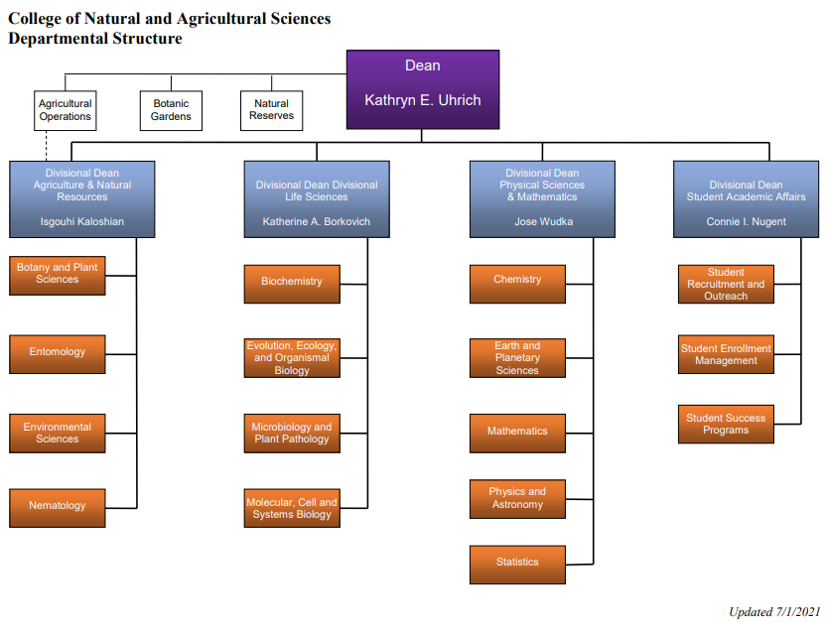

Slide 6
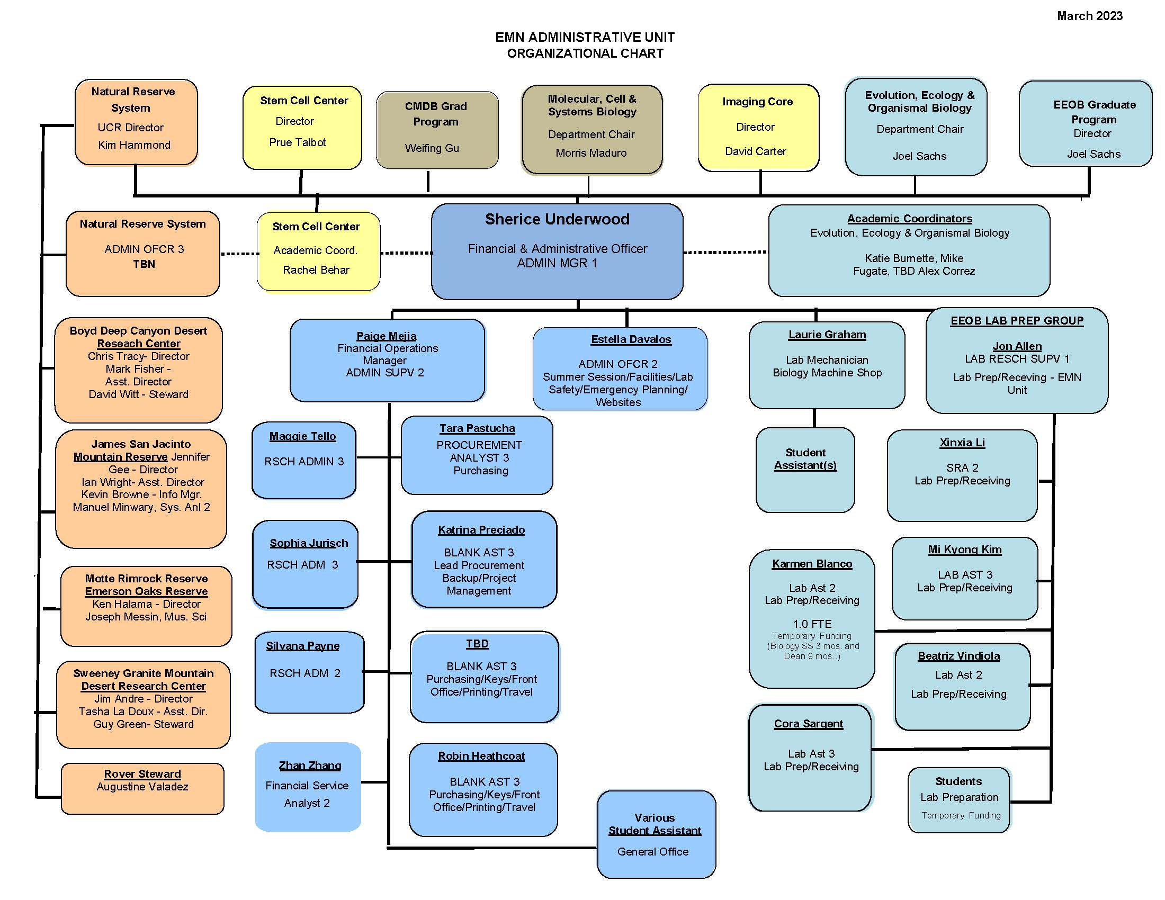

Slide 7
EMN Website, Contacts & Administrative Unit Guide
EMN Website
emn.ucr.edu
EMN Administrative Staff Contacts
emn.ucr.edu/people/staff
EMN Administrative Unit Guide
emn.ucr.edu/people/staff

Slide 8
Academic Personnel, CNAS contacts
MCSB
Academic Analyst, Claudia Morales
Tel: (951) 827-4431
Email: Claudia.morales@ucr.edu
EEOB
Academic Analyst, Nicole Tardy
Tel: (951) 827-3997
Email: nicole.tardy@ucr.edu
EEOB and MCSB
Academic Assistant, Troy Hall
Tel: (951) 827-3068
Email: troy.hall@ucr.edu

Slide 9
Human Resources & Payroll Contacts
Harvest Human Resources Generalist; Payroll
Sandra Burroughs
Tel: (951) 827-2765
Email: NAPSUPodE@ucr.edu
Harvest Payroll Assistant
Jay (NJ) Nguyen
Tel: (951) 827-4059
Email: NAPSUPodE@ucr.edu
UC Path Portal
Paystub, specific benefit questions (enrolling/un-enrolling)

Slide 10
Standards of Personnel Conduct/Ethics
The University of California, Riverside is committed to equitable treatment of all students, faculty and staff and UCR’s faculty, staff and students are committed to creating an environment for their contribution.
There are 3 objectives that our campus must strive towards in order to achieve these goals.
First, ensure that we have an environment that nurtures the intellectual and personal growth of our students, faculty and staff.
Second, ensure that our campus sets an example of respect for all people.
Third, ensure that our campus is a safe and welcoming environment for everyone.
See more on the HR website: Principles of Community

Slide 11
Workplace Health & Safety
Smoke Free/Tobacco Free
All UCR owned and leased properties are smoke and tobacco free.
The use of cigarettes, cigars, pipes, water pies (hookah), smokeless tobacco products and e-cigarettes is strictly prohibited in all indoor, outdoor, parking lots, etc.
See more on the UCOP website: Smoke & Tobacco Free Policy
Substance Abuse Free
The University of California, Riverside strives to maintain its campus community free from illegal use, possession or distribution of alcohol or controlled substances as defined by federal law.

Slide 12
New Employee Benefits
New Employee Benefits Orientation Webinar
Must choose benefits within 31 days from date of hire (DOH).
Please attend a live and weekly interactive Benefits Orientation Webinar which is offered every Friday from 10:30am-Noon.
To join the live webinar online go to: https://UCOP.zoom.us/j/9517875041 (www.zoom.us), Join a meeting, Meeting ID code: 9517875041
Phone Audio: (408) 638-0968, Meeting ID 9517875041
A pre-recorded session is available on: https://www.ucop.edu/ucpath-center/_files/mypath/benefits/new-employee-benefits-orientation.pdf
New Employee Benefits Onboarding PowerPoint
For full information relating to New Employee Benefits, please visit: https://ucnet.universityofcalifornia.edu/compensation-and-benefits/benefits-of-belonging.html

Slide 13
New Staff Campus Orientation
Welcome! The UCR New Staff Orientation (NSO) program has a long history of quickly making new staff feel right at home in their new work environment. As a new employee, you are now part of what makes this University so great – the people! Staff Orientation is a great way to learn about the history of UC and UC Riverside, the mission of the University, our future goals, campus growth and much more. The NSO provides this information and much more from various presenters in an engaging and interactive format.
Please work with your Supervisor to register at least 5 days in advance through the UC Learning Center by visiting: https://ucrlearning.ucr.edu
Why You Should Attend
The more you know about UCR, the more you will benefit from the many opportunities available. Staff orientation also provides an opportunity for you to meet fellow colleagues and network. Employees from departments all over campus attend, so you will be able to add to your list of campus contacts and friends!
What to Expect
In an effort to protect the health and safety of its community during the COVID-19 outbreak, UC Riverside continues to be closed for non-critical functions, and as a result, the usual in-person monthly UCR New Staff Orientation session is being conducted virtually via Zoom until further notice.

Slide 14
Workplace Safety – Ergonomics
Ergonomics is the applied science of equipment design and/or workplace design, intended to maximize productivity by reducing operator fatigue and discomfort. Also called biotechnology, human engineering, and human factors engineering.
Ergonomics includes the following characteristics:
Science of fitting jobs, tools or environments of work to the worker.
Encompasses the workstation, the tools or equipment of work, and the workflow design.
The goal is to prevent, or reduce the likelihood of, discomfort and injury associated with any and all aspects of work.
See more details on https://humanresources.ucr.edu/front/workplace-health-wellness/ergonomics
Ergonomics Specialist
Dr. Clyde Blackwelder
Workplace Health & Wellness, Human Resources
University of California, Riverside
clyde.blackwelder@ucr.edu
ergoevaluation@ucr.edu
(951) 827-3010
Please work with your supervisor to schedule a workplace assessment within 30 days of hire.

Slide 15
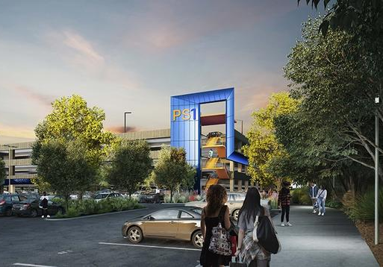
Campus Parking
After your first day, you will need to purchase a parking permit from Transportation and Parking Services (TAPS). You will need to show a photo ID and inform TAPS that you are purchasing a new parking permit. Please note that TAPS accepts MasterCard, VISA, cash, and checks but not American Express. If you would like your fees to come out of your payroll, please inform TAPS that you would like to authorize direct withdrawal of fees.
TAPS is open from 8am-4pm, Monday-Friday and is located at 683 Linden Street, Riverside, CA.
You may contact their office at (951) 827-8277 for questions related to parking.
See more details on their website: TAPS

Slide 16
Campus Mandatory Training
Mandatory UC training activities are completed on UC Learning Center by visiting: https://ucrlearning.ucr.edu .
Please complete training activities within 30 days of DOH & Annually.
UC Cyber Security Awareness Training
UC Sexual Violence and Sexual Harassment Prevention Training
General Compliance Briefing: UC Ethical Values and Conduct
Covid-19 Prevention Training

Slide 17
Access for Computer & UCR Applications
R’Space Staff Portal: rpaceportal.ucr.edu
UC Path Portal: ucpath.universityofcalifornia.edu
What is my NetID? Why is it important?
The MyAccount Portal is the central tool for managing your UCR identity - it allows campus faculty, staff and students to view and edit account access preferences - change/update your password, manage security questions, as well as provide a pathway to enroll in Multi-Factor Authentication.
Notes:
I’ll see if I can find info on NetID etc.; also may want to add info on multi authentication steps here. Can you fix it so that the first line isn’t cutting of “portal”

Slide 18
Attendance & Pay
Time & Attendance
Access and submit your timesheet
Access timesheet through the R’Space Staff Portal on: rspace.ucr.edu
When are timesheets due? This is important!
Monthly Time and Attendance Schedule
Biweekly Time and Attendance Schedule
UCR Paydays
When can I expect my first check?
Monthly PayDay Calendar
Biweekly PayDay Calendar
How is my first check distributed?
Live paycheck
Direct Deposit
UCR Holiday & Campus Closure Academic Calendar
(click here)

Slide 19
Vacation/Sick/Comp Time
( See details on Leave Accrual Records )
Vacation Time
What is my accrual?
This varies so please be sure to ask.
Sick Time
12s days prorated/8 hours per month
Comp Time Off
What is CTO?
Who can accrue CTO
Non-Exempt EE only
Notes:
Maybe you can pull some basic infor about vacation accruals etc. from here, or refer them to this link https://accounting.ucr.edu/payroll-coordination/leave-accrual

Slide 20
Performance Appraisal Process
The probationary period is dependent on your Union (if you have one) and is anywhere from 3-6 months from your DOH.
Probationary Period Example (DOH is 5/1/2022)
5/1/2022 – 8/1/2022
3-month review
What is working
What do we need to still work on
8/1/2022 – 11/1/2022
6-month review
How’d we do
Career Status
Annual Performance Appraisal Process
2022/2023 Appraisal Cycle
4/1/2022-3/31/2023
Performance Appraisal Form
Goal Agreement Form
Individual Development Plan (IDP)

Slide 21
Safety & Emergencies
Please Verify on Day 1
Emergency Exits for Main Office Bldg. (see map on wall above drinking fountain)
Emergency Exits for Work Site Location (see map on wall above drinking fountain)
UCR Campus Emergency Assembly Areas
for Life Sciences, please assemble in the Batchelor Hall grass area
check in with the person wearing an orange vest
Who do I report any unsafe conditions to?
EMN Admin Department Safety Coordinator, Estella Davalos (estellad@ucr.edu)
EMN Admin COVID-19 Guidance & Information: emn.ucr.edu/covid-19-information
UCR Campus COVID-19 Information: ehs.ucr.edu/coronavirus

Slide 22
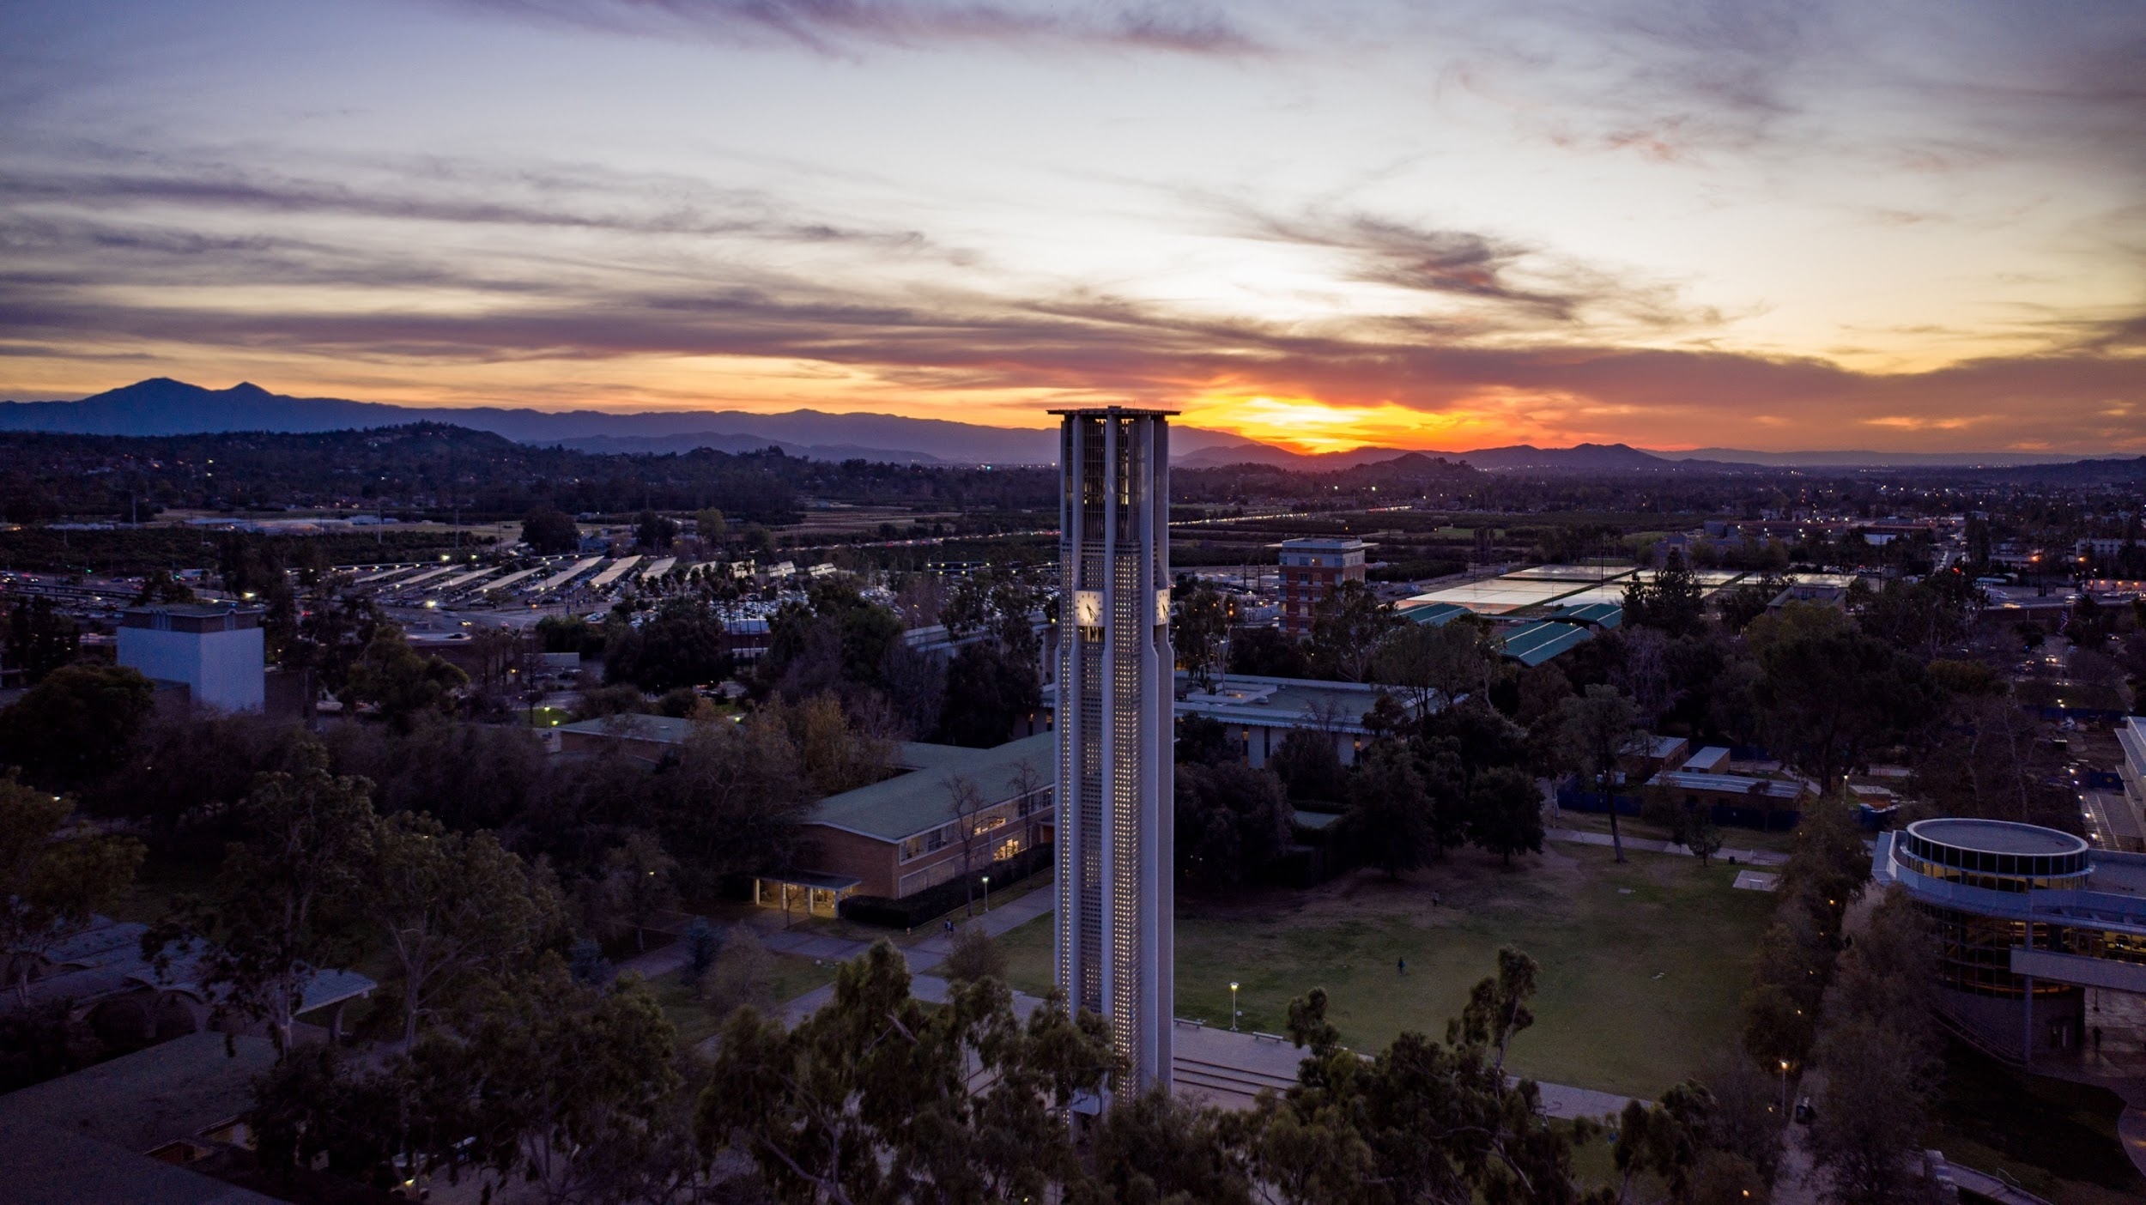
Employee Assistance Program
The Faculty and Staff Assistance Program (FSAP) is designed to offer confidential counseling, referral and other needed services to staff, faculty and their family members with personal concerns. FSAP offers assistance with a wide range of needs including:
Child and elder Care Needs
Credit or Financial Concerns
Family Problems
Legal and Personal Matters
Parenting Issues
Stress
Your toll-free number give you direct, 24/7 access to a Guidance Consultant, who will answer your questions and, if needed, refer you to a counselor or other recourses.
24/7 Support
Call: (866) 615-3047
TTY: (800) 697-0353
Online: guidanceresources.com
App: GuidanceNow
Web ID: UCRFSAP

Slide 23
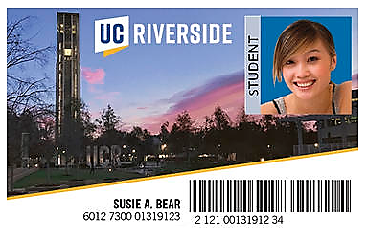
UCR Card Services – R’Card
The R’Card provides access to things like:
Campus libraries
UCR Athletic Events
UCR lab rooms
Residence Halls
Vehicle access gates
Labptop rentals and other equipment
ASPV – live events
The R’Card can be used as payment for:
The UCR Bookstore
Campus dining venues
Pepsi vending machines
WEPA Printing kiosks
Campus convenience stores (Scotty’s
Residential restaurants (with Bear Bucks, board plan or R’Blocks)
The Highlander Service Station (print, copy and postal service)
Please visit myphoto.ucr.edu with your netid and password, follow the directions to apply and upload an approved photo.
What is an R’Card?
The UCR ID Card (R’Card) is an interactive ID that facilitates commerce and access across the campus (and beyond) for students, staff and faculty. You will want to keep with you at all times.

Slide 24
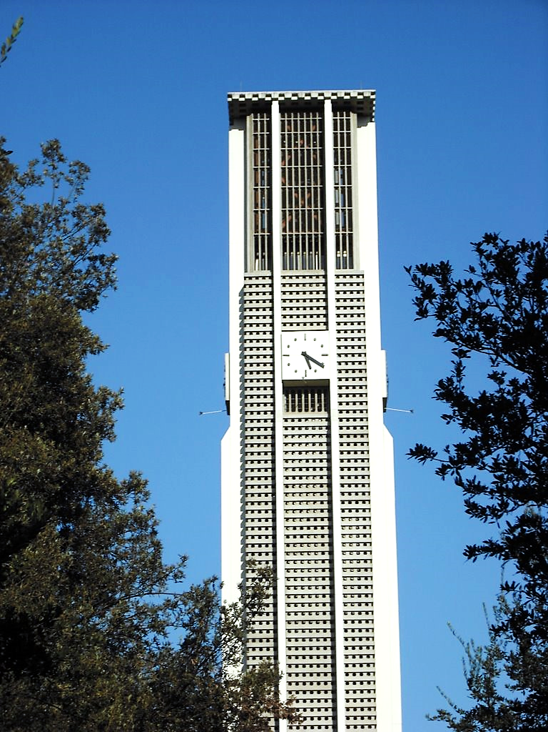
UCR Discounts
This is a Sub Header
UCR employees are eligible for an abundance of discounts. Here you will find discounts on everything from phone service to shopping, lodging and dining around the UCR campus.
UCR Discounts website: https://humanresources.ucr.edu/employee-resources/ucr-discounts
Cell Phones
Learning Discounts at UCR Extensions
Dining, events and entertainment
Lodging and transportation
Health
Shopping

Slide 25
Training & Professional Development
UCR Learning Center (LMS)
459 courses on topics such as Business and Operations, Diversity, Performance Management, Professional Skills and Career Development, UCR Essentials, etc.
My UC Career (6 self paced modules to help employees discover their internal UC career mobility options).
LinkedIn Learning
Courses, videos, learning paths, links and documents on topics such as Career Development, Professional Development, Microsoft Office, Finance and Accounting, Customer Service and Project Management.
Human Resources Website
https://hr.ucr.edu/employee-and-organizational-development

Slide 26
UCR Communications
(communications@ucr.edu)
All staff employees should receive a weekly email from UCR Communications.
These emails are a summary of activity coming up at UCR or things that you need to know about.
If you are not receiving these emails, please let your supervisor know.
VCSA News
Notices to all VCSA staff with important updates, staff announcements.
UCR Events Calendar
A link to all features events being held on the UCR campus can be found on events.ucr.edu
Campus Life
Get involved and inspired, go to ucr.edu/campus-life

