Slide 1
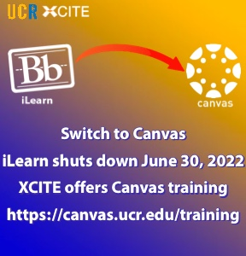
Canvas
Important points

Slide 2
Setting up courses in Canvas
Learning Canvas will annoy and frustrate you. Get in front of it as soon as possible!
your Account: Dashboard, Profile, Courses
Publishing, visibility
Adding students
Turning off grading scales and totals

Slide 3
elearn.ucr.edu

Slide 4
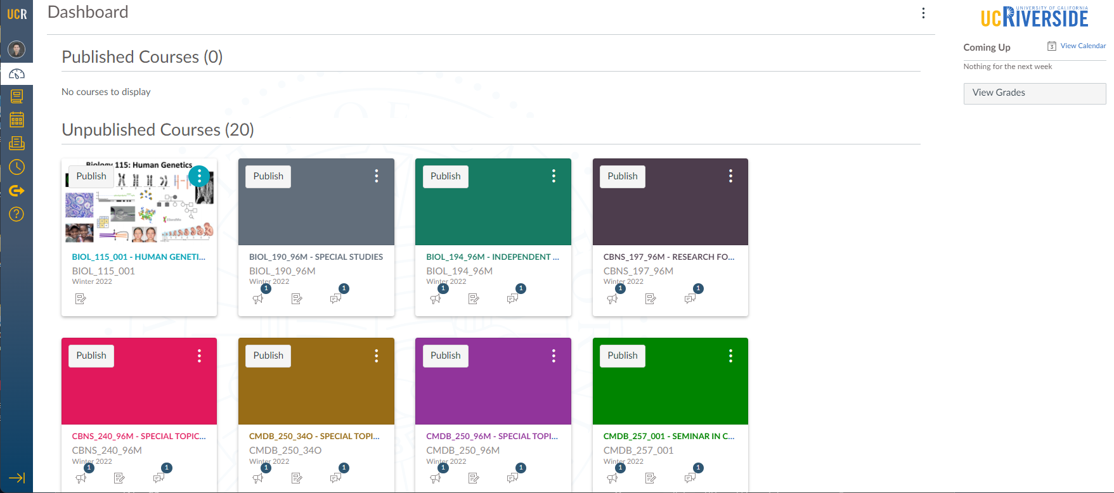
Canvas Dashboard

Slide 5
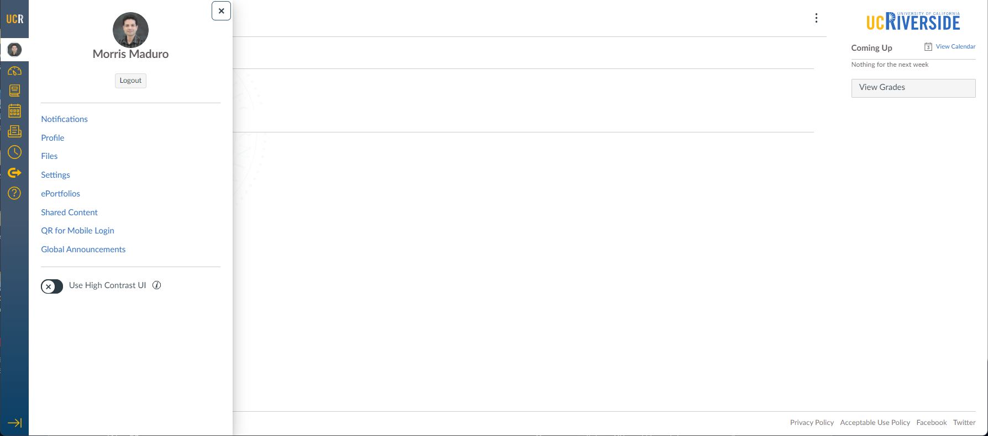
(1) Create a Profile (Account > Profile)

Slide 6
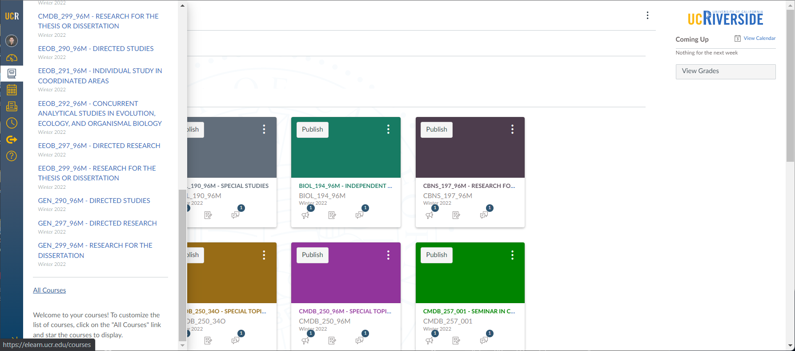
(2) Simplify the list – Courses > All Courses

Slide 7
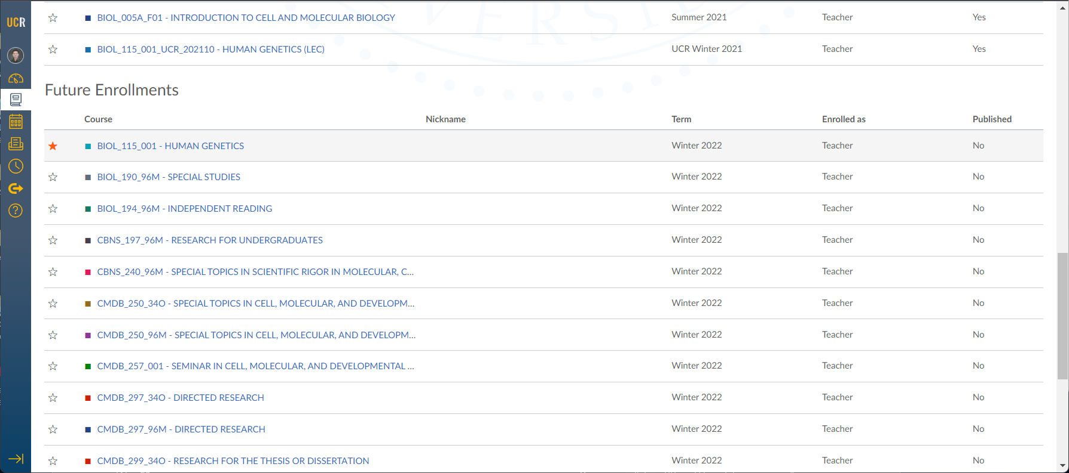
Click the star by the courses you need

Slide 8
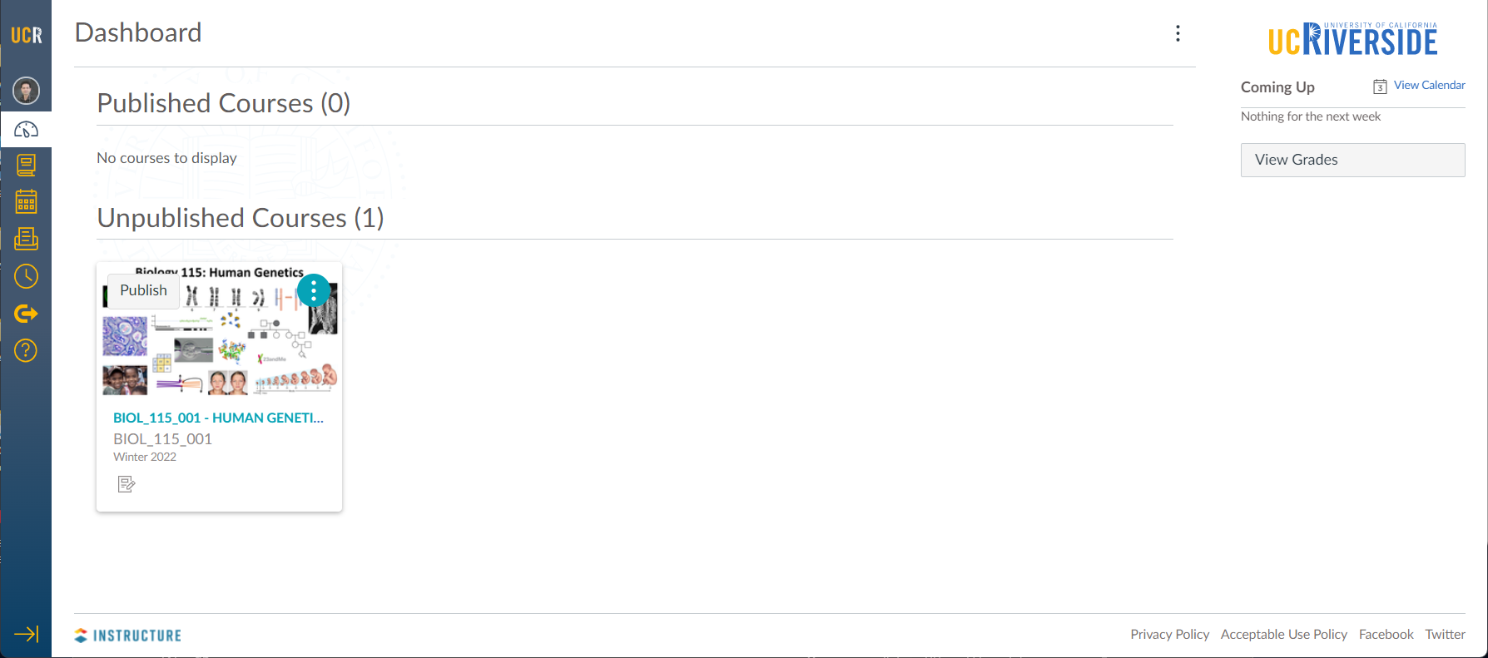
(3) Go to your course
Canvas does not make things available to students until they are ‘Published’ – this includes the course itself and each item

Slide 9
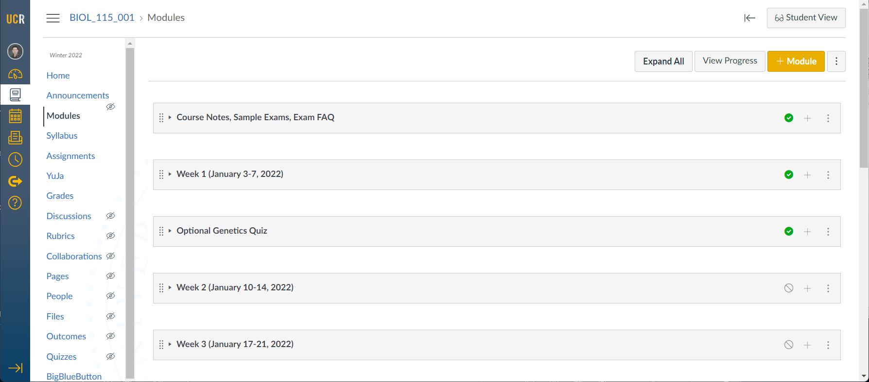
Everything in Canvas lives in a specific place. Modules are where you put most content.

Slide 10
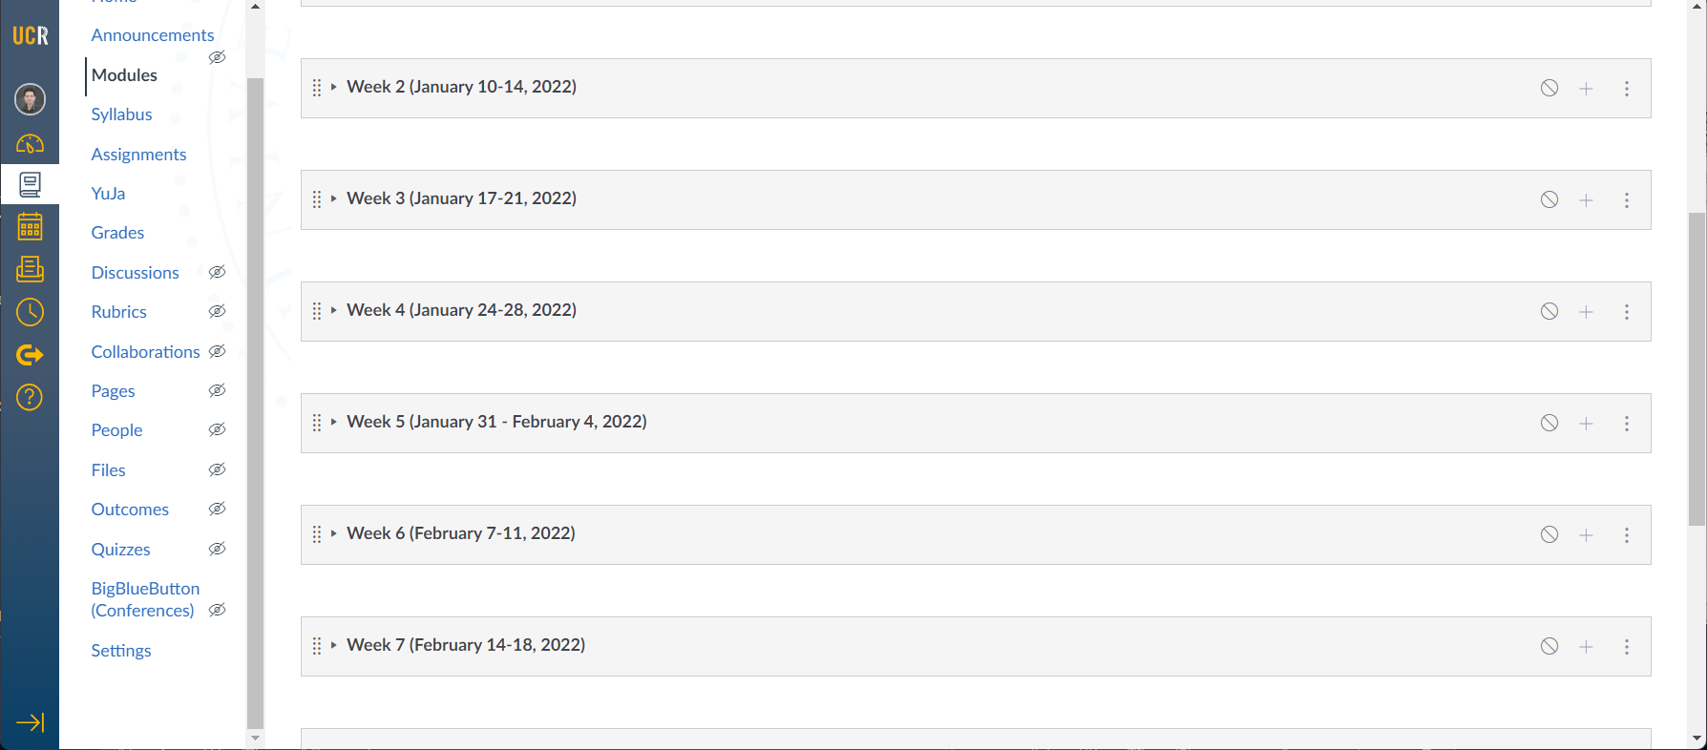
(4) I recommend you change default settings

Slide 11
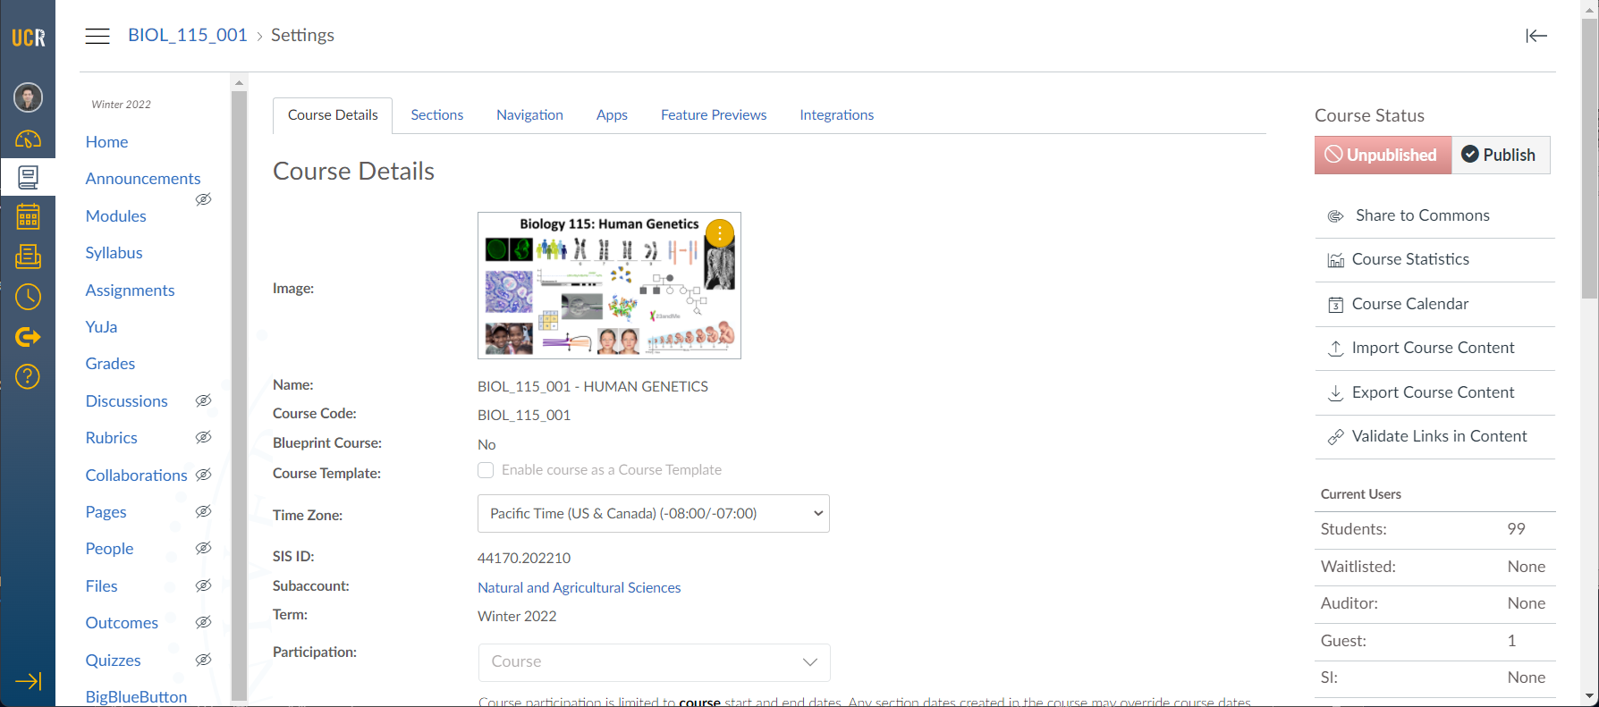
Add an image (optional)

Slide 12
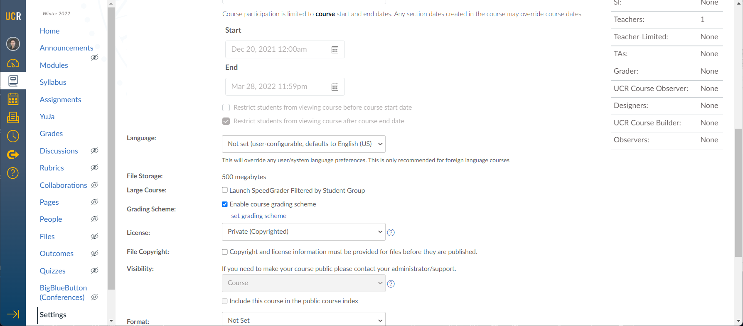
I recommend turning OFF course grading scheme

Slide 13
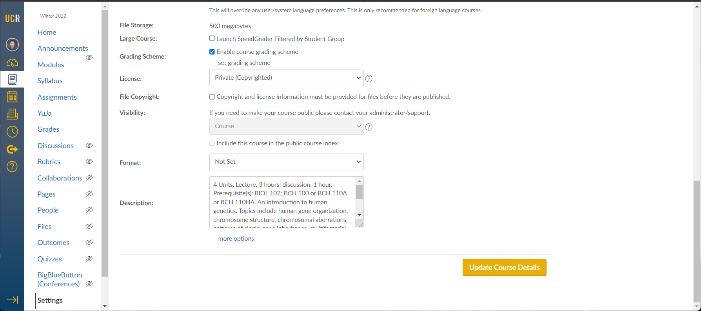
Go to more options at the bottom

Slide 14
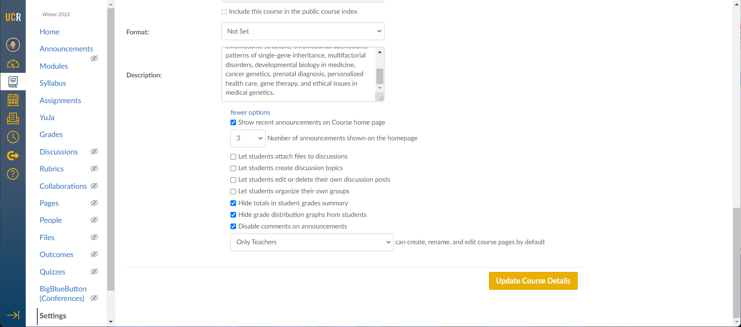
I recommend turning off various features

Slide 15
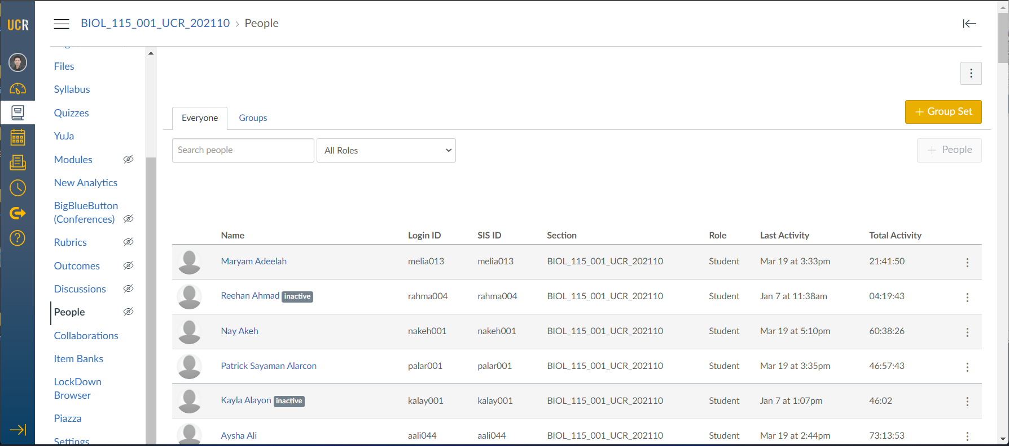
Go to People
‘Inactive’ are dropped students

Slide 16
New: You can add people

Slide 17
Student roles:
Student*, Guest, Waitlisted, SI, Auditor
Teacher roles:
Teacher*, TA*, Teacher-Limited, Grader
Specialty roles:
Designer*, Observer*, UCR Course Builder
*Canvas roles; others are UCR-specific

Slide 18
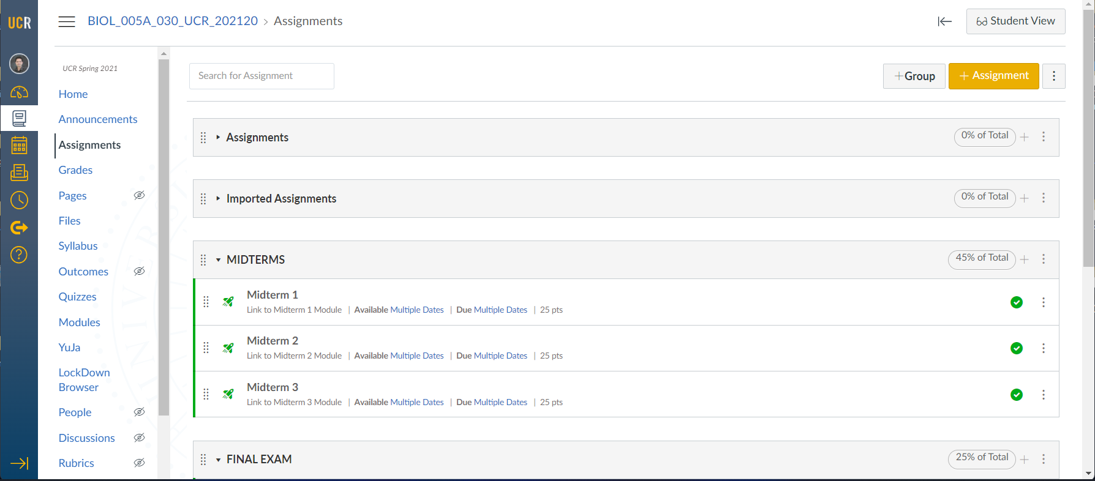
Assignments – where all points live

Slide 19
To weigh points – Create Assignment Group

Slide 20
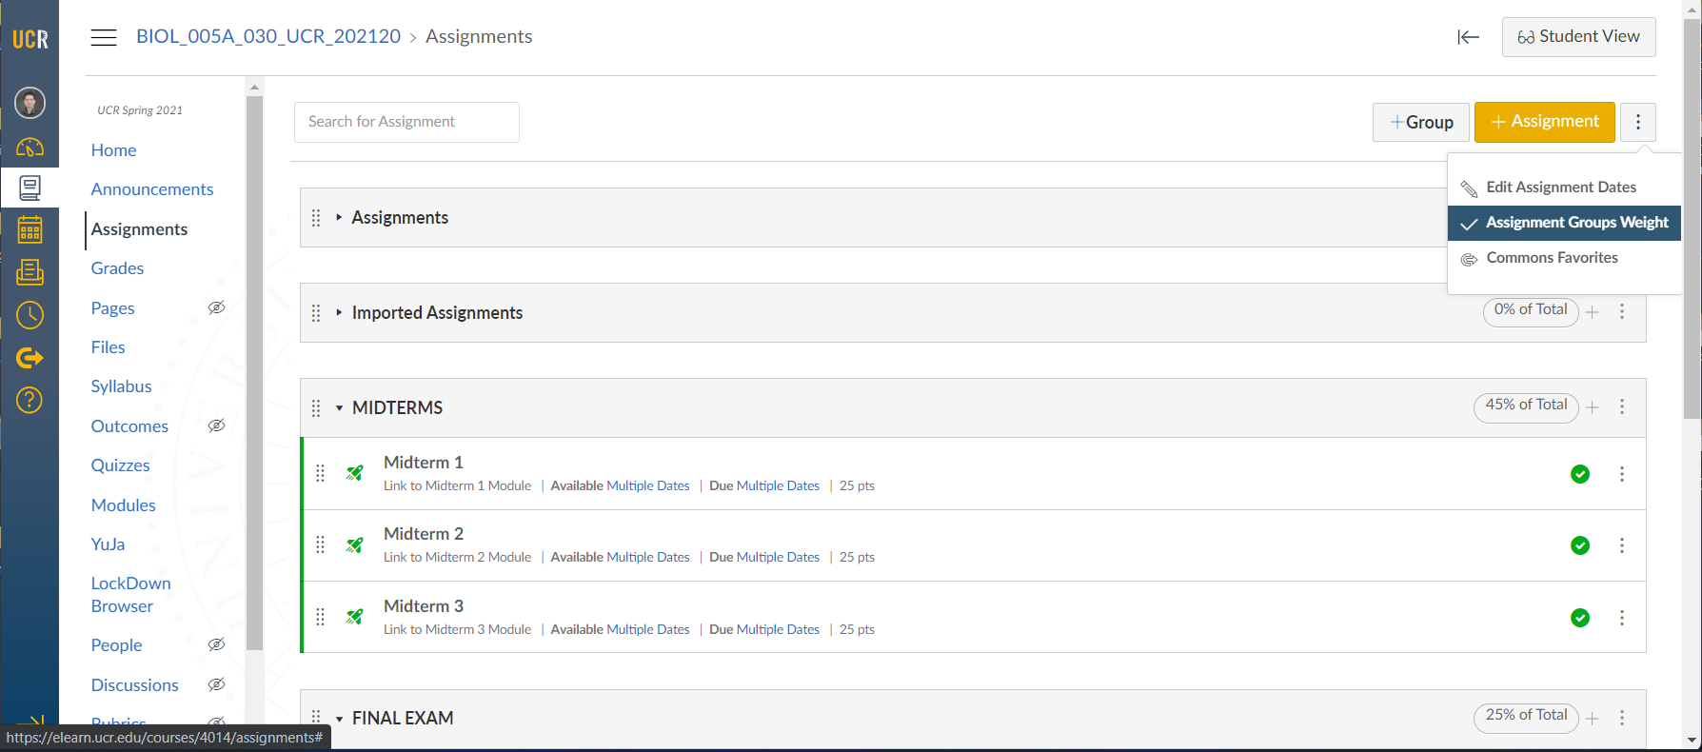
To weigh points – click the kebab menu

Slide 21
Grades – this will take getting used to
Cannot move columns around
Cannot post anything but a score
The SID can be seen but not downloaded
Secondary Info > Integration ID
Missing items are not given zeros
Cannot post letter grades directly: Assign weightings to all assessments (in Assignments > Assignment Groups) and use a Course Grading Scheme

Slide 22
Gradebook

Slide 23
Instructure Community (community.canvaslms.com)
UCR Canvas site (canvas.ucr.edu)

